Slide 1
Android Final Project:
My Drug Journal
邱嘉香 104590049
林大衛 104590050

Slide 2
Topics
Introduction
Tools used
Database
User interface
Functionality & classes
Demo

Slide 3
Introduction
Our project consists on a kind of journal that can be used to keep track of medicines that have to be taken by the user, while also saving other important information in case of emergency

Slide 4
Tools used
Android components
Activities
Fragments
Recycler view
Cards and gestures
Broadcast receiver
Navigation drawer
Intents
Time picker
Date picker
Other tools
Gson
Lombok
Android-Week-View
CountryCodePickerProject
Firestore
Firebase Authentication
Canva
Android Asset Studio

Slide 5
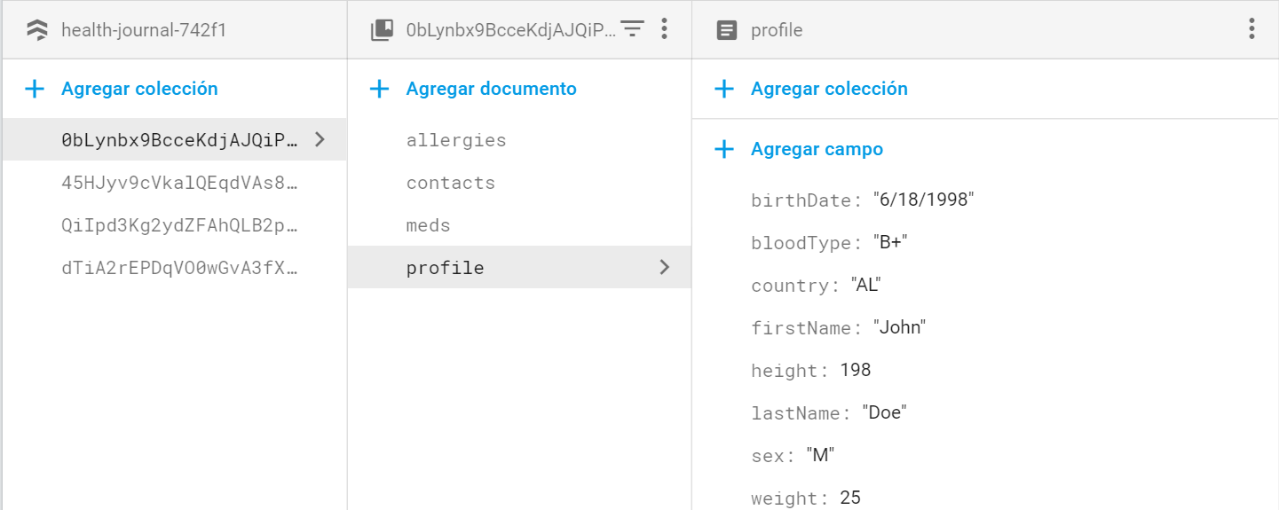
Database
We used NoSql Firestore database

Slide 6
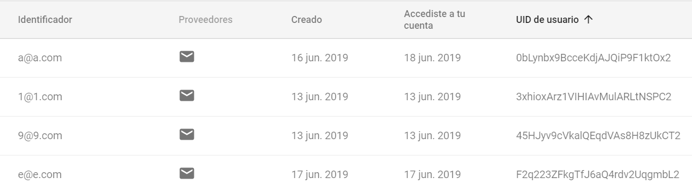
Database (cont)

Slide 7
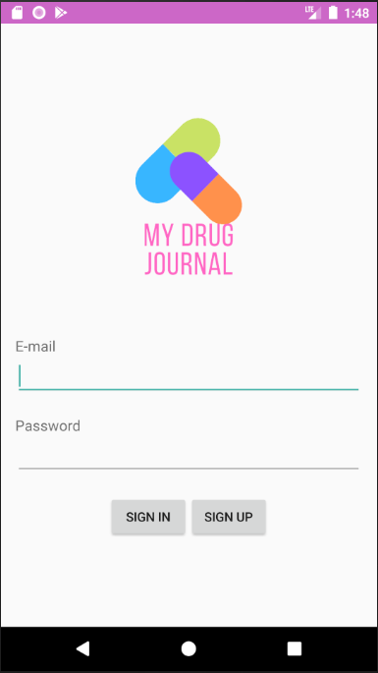
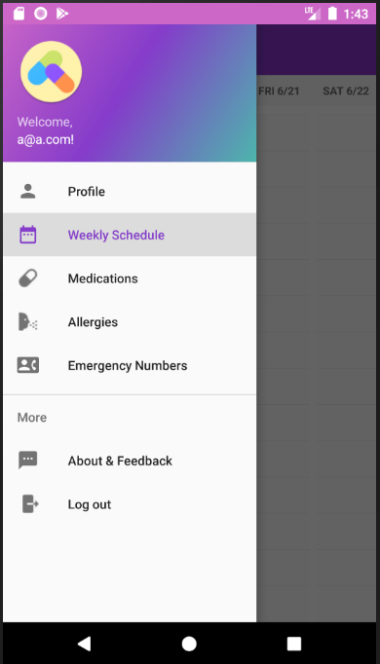
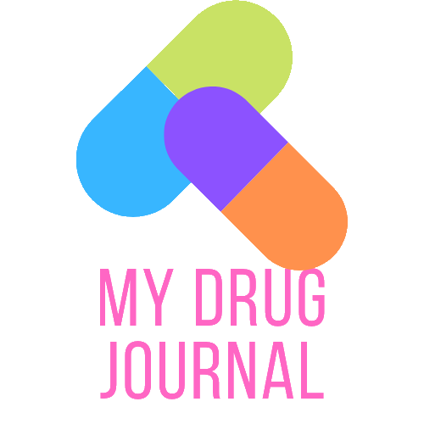

User Interface
Logo & launcher icon

Slide 8
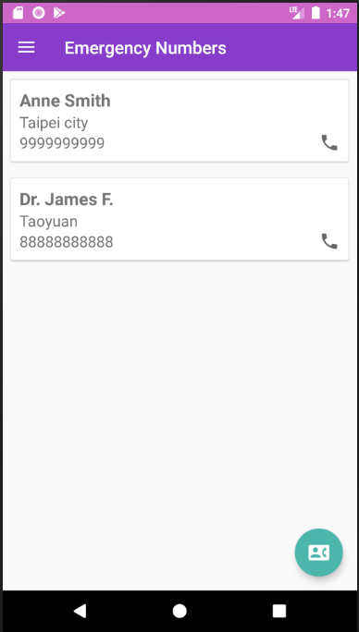
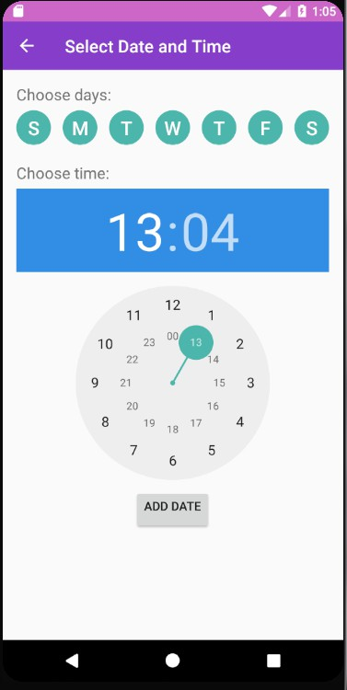
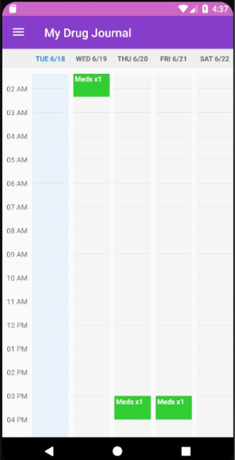
User Interface (cont.)

Slide 9
Functionality and classes
Add medications | AddNewMedicationActivity, MedicationModel,MyMedicationsFragment, MedicationRecyclerAdapter
Add allergies | AddNewAllergyActivity, AllergyModel,MyAllergiesFragment, AllergiesRecyclerAdapter
Add / call emergency contacts | AddNewEmergencyContactActivity, EmergencyContactModel,EmergencyContactsFragment, EmergencyContactsRecyclerAdapter
Add medications to calendar | AlertReceiver, AddToCalendarActivity, AddToCalendarDialog
See / edit user profile | UserProfileFragment
Sign in / Sign up | SigninActivity, SignupActivity, MainActivity

Slide 10
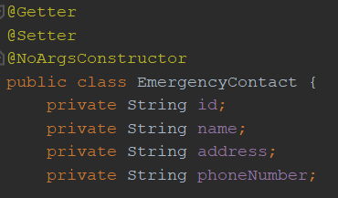
Lombok

Slide 11
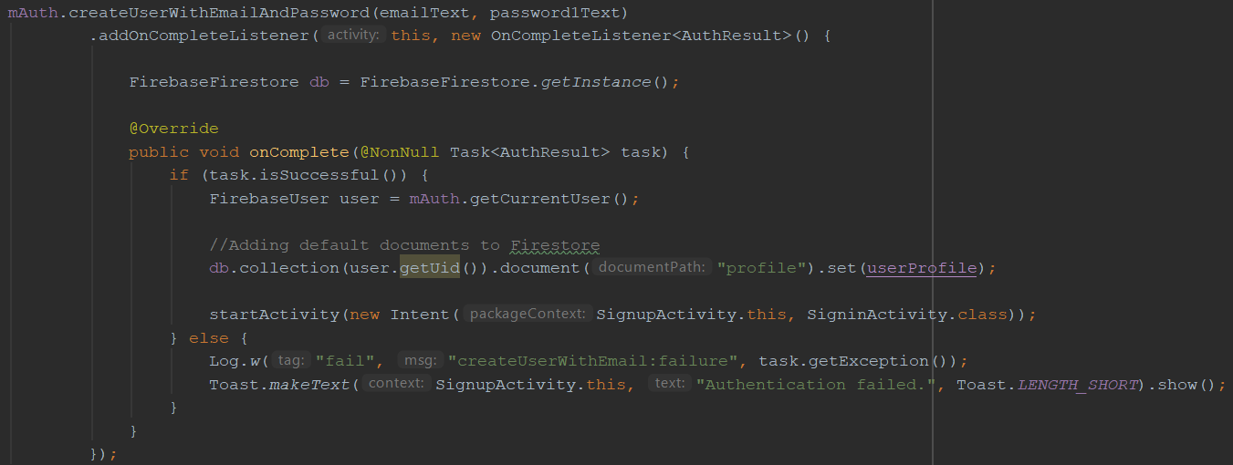
Sign up with Firebase Authentication

Slide 12
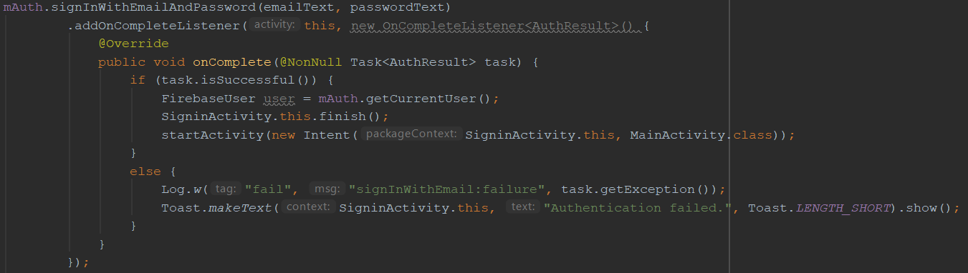
Sign in with Firebase Authentication

Slide 13
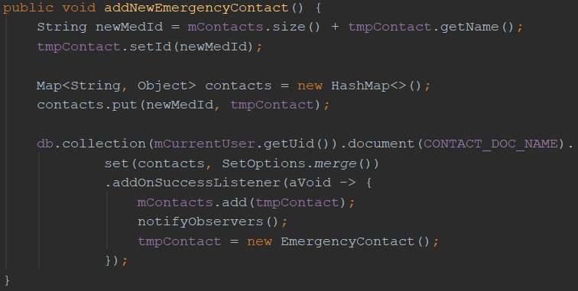
Adding data to Firestore

Slide 14
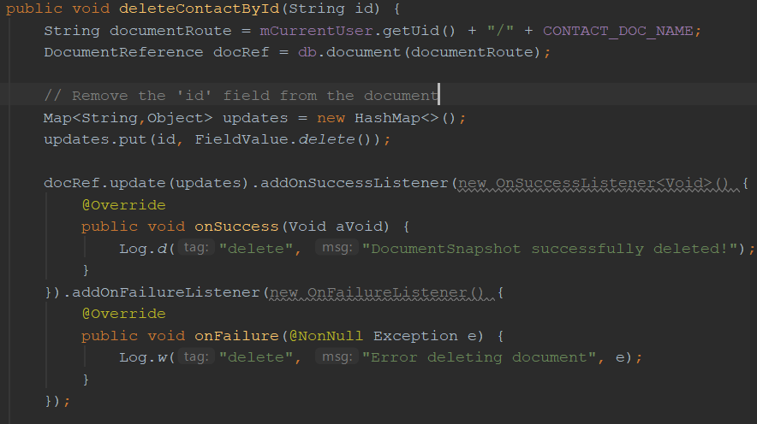
Deleting data from Firestore

Slide 15
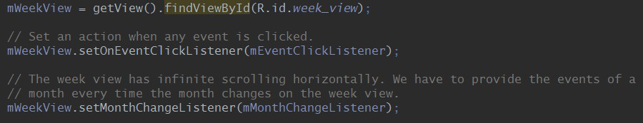
Android Week View library

Slide 16
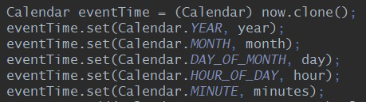
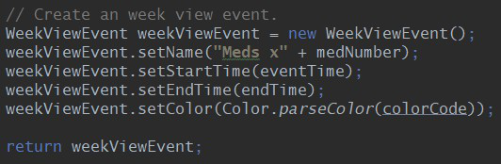
Feeding the WeekView

Slide 17
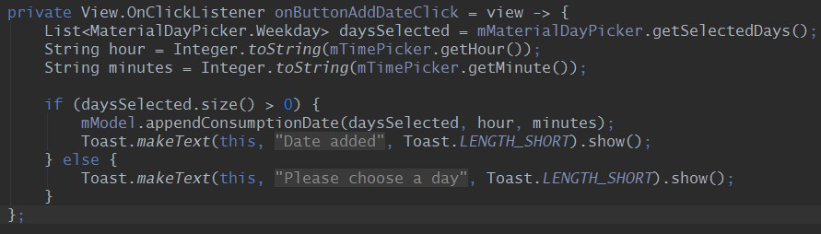
Date and time picker

Slide 18
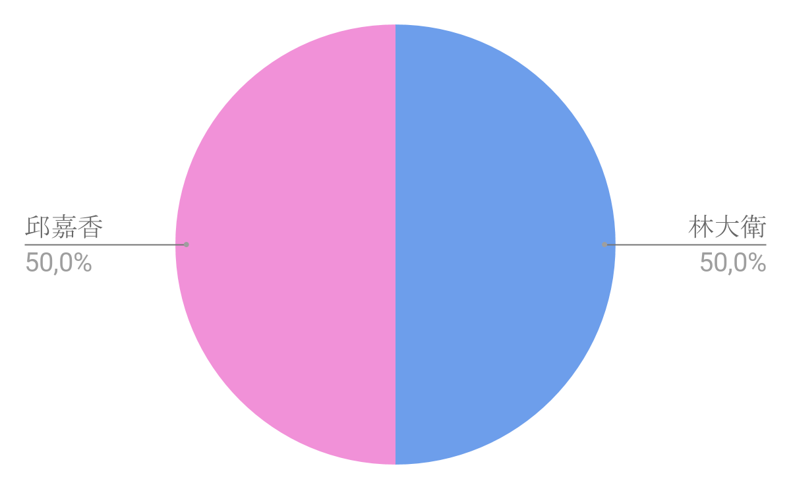
Members’ contribution

Slide 19
Demo

